Slide 1
Buddhism
An extension of Hinduism

Slide 2
Siddhartha Gautama
In 500 BC Siddhartha was a prince in his father’s castle
Bribed a charioteer to take him outside the castle walls where he saw illness, poverty, and death
It bothered him so much he left his royal life, wife, and child, and began a quest to find answers. He was 29.
Does this remind you of any other stories we have heard (think Disney)

Slide 3
Finding Answers
Siddhartha became an Ascetic= one who rejects worldly things
After six years of suffering with no food, a home, or clothes, he sat under a Bodhi (fig) tree to try and understand
Here, he realized he was no happier having nothing than he was having everything

Slide 4
Buddha becomes the “Enlightened One”
This is when Siddhartha became the “Buddha” aka Buddha is a real person
The Middle Way is what he believe brought him happiness
In between poor and rich
It is how people will reach Nirvana

Slide 5
Four Noble Truths
Life is ________________________
Suffering comes from wanting things (_______________)
People can _____________ suffering
They must _____________ to end suffering

Slide 6
Eightfold Path
People can end suffering by seeking the Eightfold Path. It consists of eight “________________” attitudes.
Right View
Right Intentions
Right Speech
Right Actions
Right Livelihood
Right Efforts
Right Mindfulness
Right Concentration

Slide 7
Buddha’s Legacy
Buddha lived till he was __________
Buddhism is the world’s _______________ largest religion.
Buddhism is now one of the world's fastest growing religions
Why?
Buddhism teaches “___________________” which means Do No Harm
Buddha believed in ______________ and ____________

Slide 8
Extension
_______________ Buddhism was started in China, but drifted to Japan
_____________ warriors used Zen Buddhism to find inner peace and conquer fear
___________________________ who created Star Wars is a Buddhist Methodist.
There’s a lot of Buddhist symbolism and language in the movies

Slide 9
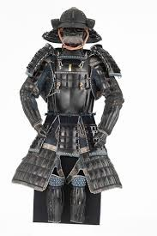
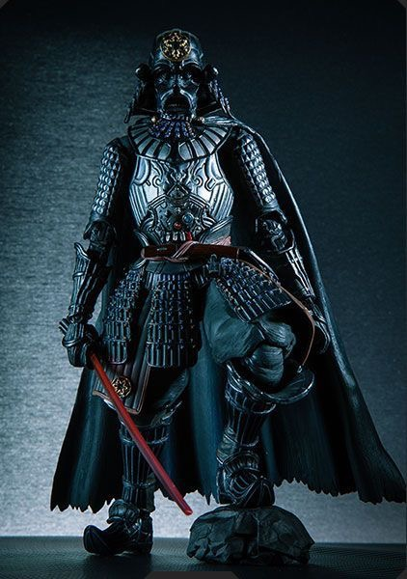
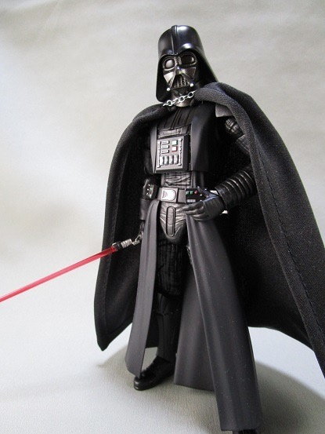
Samurai
Lego Darth Vader
Darth Vader

Slide 10
Training

