Slide 1
Judaism

Slide 2
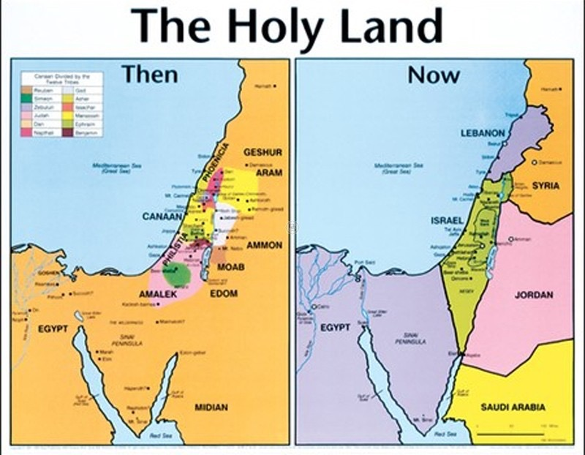
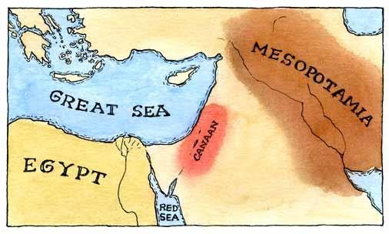
History
1st monotheistic religion
Started in Canaan
Present day Israel

Slide 3
Important people
Abraham
Father of the Hebrew people
God commanded Abraham to kill his Son Isaac in order to test his loyalty to the religion however an angel stepped in and he did not kill them. This proved his loyalty.
Jacob
Abraham's grandson
His 12 sons represent the 12 tribes of Israel
Moses
Led the Hebrew people to freedom from the Egyptians
“Parted the red sea”
Story of Passover

Slide 4
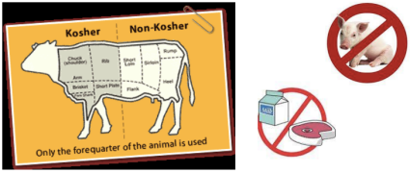
Worship
Rabbis: Jewish leaders and teachers
Synagogues: Places for Jewish prayer and worship
Messiah: Hebrew word that means an “anointed one” charged with some task or leadership
Kosher: food that satisfies that requirements of Jewish law
This includes the restrictions of Pork, shellfish, mixing meat/cheese

Slide 5
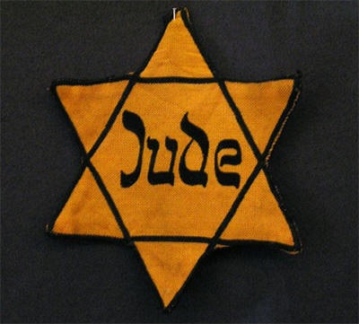
Hate
Diaspora: Movement of Jews to other parts of the world
Anti Semitism: prejudice against Jews
Holocaust: A mass genocide where over 6 million Jews were killed
Jews are still persecuted today

Slide 6
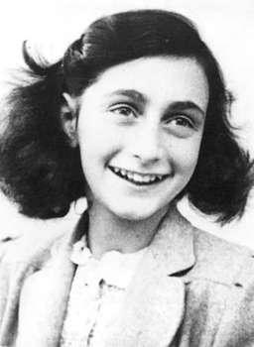
Holocaust
World War II
1939-1945
Hitler and Nazis
Took place in Germany and other surrounding countries such as Poland, Austria, Ukraine, Norway, the Czech Republic, Slovakia, Belarus, the Netherlands, and France.
Concentration Camps
Anne Frank and many other diaries are ways we have evidence of what happened

Slide 7
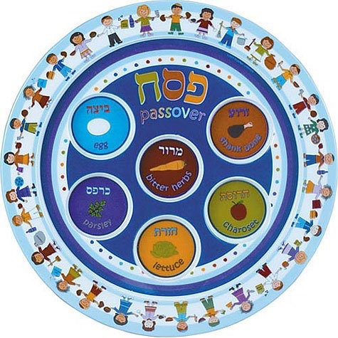
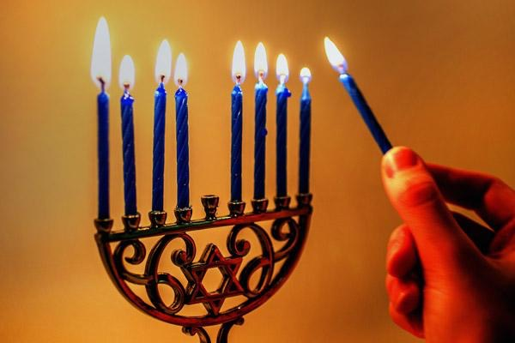
Holidays
Hannukah- Festival of lights
Light candles for 8 nights
Menorah
Shamish- lighter candle
Passover- Celebrate the freedom from Egypt
“Pass Over” the house
Matzah- unleavened bread because Jews left so quickly the bread did not have time to rise
Yom Kippur- “Day of Atonement”
Fast for 24 hours
Rosh Hashanah- New Years
Apples and Honey for a Sweet New Year

